Slide 1
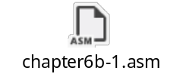
Chapter 6b: Homework
1. Implement the following C++ code in assembly language, using the block-structured .IF and .WHILE directives. Assume that all variables are 32-bit signed integers:
int array[] = {10,60,20,33,72,89,45,65,72,18};
int sample = 50;
int ArraySize = sizeof array / sizeof sample;
int index = 0;
int sum = 0;
while( index < ArraySize )
{
if( array[index] <= sample )
{
sum += array[index];
}
index++;
}
Irvine, Kip R. Assembly Language for Intel-Based Computers 5/e, 2007.

Slide 2
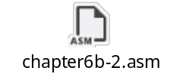
Chapter 6b: Homework
2. Based on the FSM diagram for hexadecimal integer constant that conforms to MASM syntax given in page 28 of the slides of Chapter 6b:
1) Draw flowcharts for all the states in the FSM.
2) Implement the FSM in assembly language. Let the user input a hexadecimal constant from the keyboard.
3) Test the program using different inputs and make sure each line of your code is covered.
Submit the source code of your program and the screenshots of the inputs and outputs of your program. Explain each pair of your input and output.
Irvine, Kip R. Assembly Language for Intel-Based Computers 5/e, 2007.

Slide 3
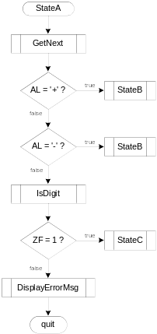
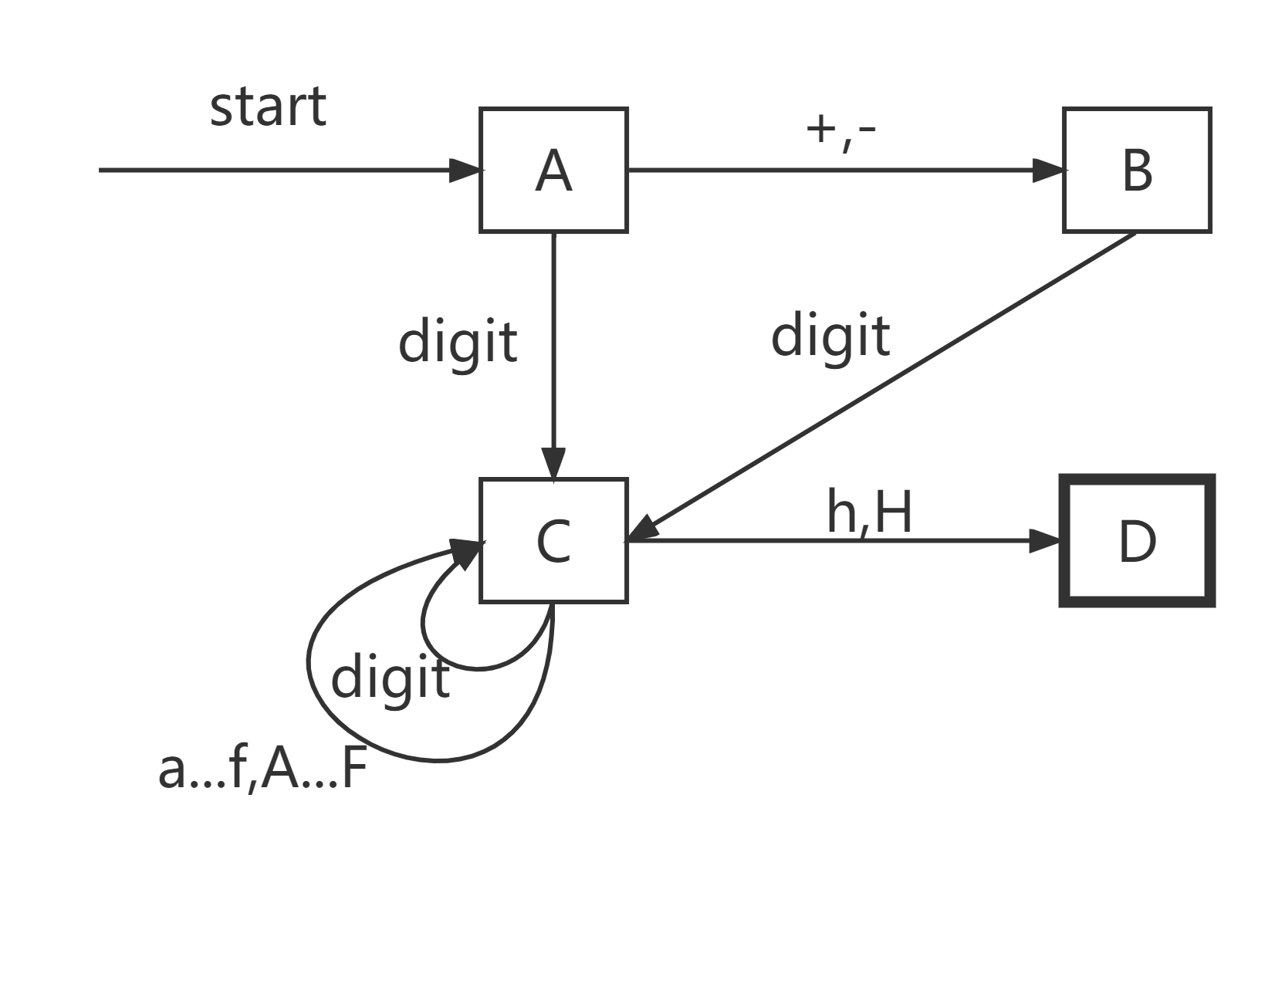
Flowchart of State A
State A accepts a plus or minus sign, or a decimal digit.
Irvine, Kip R. Assembly Language for Intel-Based Computers 5/e, 2007.

Slide 4
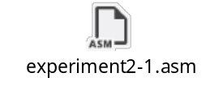
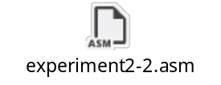
Experiment 2
1. Write a procedure that takes three arguments: a character and two integers. The character is to be printed. The first integer specifies the number of times that the character is to be printed on a line, and the second integer specifies the number of lines that are to be printed. Write a program that makes use of this procedure.
Your report needs to include your code and record the input/output of your program in the consoler.
2. Write a procedure that sets each element in an array to the sum of the corresponding elements in two other arrays. (That is, if array 1 has the values 2 , 4 , 5 , and 8, and array 2 has the values 1 , 0 , 4 , and 6, the function assigns array 3 the values 3 , 4 , 9 , and 14.) The procedure should take each address of the three arrays and the array size as arguments. Test the procedure in a simple program.
Your report needs to include your code and record the input/output of your program in the consoler.
Irvine, Kip R. Assembly Language for Intel-Based Computers 5/e, 2007.

Slide 5
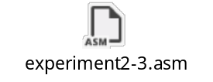
Experiment 2
3. Write a program that prompts the user to enter three sets of five integer numbers each. (You may assume the user responds correctly and doesn’t enter non-numeric data.) The program should accomplish all of the following:
a. Store the integers in a 3×5 array.
b. Compute the sum of each set of five values, and display the results.
c. Compute the sum of all the values, and display the results.
d. Determine the largest value of the 15 values, and display the results.
Each major task should be handled by a separate procedure.
Your report needs to include your code and record the input/output of your program in the consoler.
Irvine, Kip R. Assembly Language for Intel-Based Computers 5/e, 2007.

Slide 6
Assembly Language for Intel-Based Computers, 6th Edition
Kip R. Irvine
Chapter 7: Integer Arithmetic
Slides prepared by the author
Revision date: June 4, 2006
(c) Pearson Education, 2006-2007. All rights reserved. You may modify and copy this slide show for your personal use, or for use in the classroom, as long as this copyright statement, the author's name, and the title are not changed.

Slide 7
Chapter Overview
Shift and Rotate Instructions
Shift and Rotate Applications
Multiplication and Division Instructions
Extended Addition and Subtraction
Irvine, Kip R. Assembly Language for Intel-Based Computers 5/e, 2007.

Slide 8
Shift and Rotate Instructions
Logical vs Arithmetic Shifts
SHL Instruction
SHR Instruction
SAL and SAR Instructions
ROL Instruction
ROR Instruction
RCL and RCR Instructions
SHLD/SHRD Instructions
Irvine, Kip R. Assembly Language for Intel-Based Computers 5/e, 2007.

Slide 9


Logical vs Arithmetic Shifts
A logical shift fills the newly created bit position with zero:
An arithmetic shift fills the newly created bit position with a copy of the number’s sign bit:
Irvine, Kip R. Assembly Language for Intel-Based Computers 5/e, 2007.

Slide 10

SHL Instruction
The SHL (shift left) instruction performs a logical left shift on the destination operand, filling the lowest bit with 0.
Operand types for SHL:
SHL reg,imm8
SHL mem,imm8
SHL reg,CL
SHL mem,CL
(Same for all shift and rotate instructions)
Irvine, Kip R. Assembly Language for Intel-Based Computers 5/e, 2007.

Slide 11

Fast Multiplication
Shifting left 1 bit multiplies a number by 2
mov dl,5
shl dl,1
Shifting left n bits multiplies the operand by 2^{n}
For example, 5 * 2² = 20
mov dl,5
shl dl,2 ; DL = 20
Irvine, Kip R. Assembly Language for Intel-Based Computers 5/e, 2007.

Slide 12
SHR Instruction
The SHR (shift right) instruction performs a logical right shift on the destination operand. The highest bit position is filled with a zero.
Shifting right n bits divides the operand by 2^{n}
mov dl,80
shr dl,1 ; DL = 40
shr dl,2 ; DL = 10
Irvine, Kip R. Assembly Language for Intel-Based Computers 5/e, 2007.

Slide 13
SAL and SAR Instructions
SAL (shift arithmetic left) is identical to SHL.
SAR (shift arithmetic right) performs a right arithmetic shift on the destination operand.
An arithmetic shift preserves the number's sign.
mov dl,-80
sar dl,1 ; DL = -40
sar dl,2 ; DL = -10
Irvine, Kip R. Assembly Language for Intel-Based Computers 5/e, 2007.

Slide 14
Your turn . . .
Indicate the hexadecimal value of AL after each shift:
mov al,6Bh
shr al,1 a.
shl al,3 b.
mov al,8Ch
sar al,1 c.
sar al,3 d.
35h
A8h
C6h
F8h
Irvine, Kip R. Assembly Language for Intel-Based Computers 5/e, 2007.

Slide 15

ROL Instruction
ROL (rotate) shifts each bit to the left
The highest bit is copied into both the Carry flag and into the lowest bit
No bits are lost
mov al,11110000b
rol al,1 ; AL = 11100001b
mov dl,3Fh
rol dl,4 ; DL = F3h
Irvine, Kip R. Assembly Language for Intel-Based Computers 5/e, 2007.

Slide 16

ROR Instruction
ROR (rotate right) shifts each bit to the right
The lowest bit is copied into both the Carry flag and into the highest bit
No bits are lost
mov al,11110000b
ror al,1 ; AL = 01111000b
mov dl,3Fh
ror dl,4 ; DL = F3h
Irvine, Kip R. Assembly Language for Intel-Based Computers 5/e, 2007.

Slide 17
Your turn . . .
Indicate the hexadecimal value of AL after each rotation:
mov al,6Bh
ror al,1 a.
rol al,3 b.
B5h
ADh
Irvine, Kip R. Assembly Language for Intel-Based Computers 5/e, 2007.

Slide 18
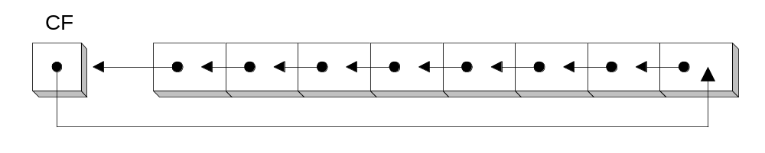
RCL Instruction
RCL (rotate carry left) shifts each bit to the left
Copies the Carry flag to the least significant bit
Copies the most significant bit to the Carry flag
clc ; CF = 0
mov bl,88h ; CF,BL = 0 10001000b
rcl bl,1 ; CF,BL = 1 00010000b
rcl bl,1 ; CF,BL = 0 00100001b
Irvine, Kip R. Assembly Language for Intel-Based Computers 5/e, 2007.

Slide 19
RCR Instruction
RCR (rotate carry right) shifts each bit to the right
Copies the Carry flag to the most significant bit
Copies the least significant bit to the Carry flag
stc ; CF = 1
mov ah,10h ; AH,CF = 00010000b 1
rcr ah,1 ; AH,CF = 10001000b 0
Irvine, Kip R. Assembly Language for Intel-Based Computers 5/e, 2007.

Slide 20
Your turn . . .
Indicate the hexadecimal value of AL after each rotation:
stc
mov al,6Bh
rcr al,1 a.
rcl al,3 b.
B5h
AEh
Irvine, Kip R. Assembly Language for Intel-Based Computers 5/e, 2007.

Slide 21
SHLD Instruction
Shifts a destination operand a given number of bits to the left
The bit positions opened up by the shift are filled by the most significant bits of the source operand
The source operand is not affected
Syntax:
  SHLD destination, source, count
Operand types:
SHLD reg16/32, reg16/32, imm8/CL
SHLD mem16/32, reg16/32, imm8/CL
Irvine, Kip R. Assembly Language for Intel-Based Computers 5/e, 2007.

Slide 22
SHLD Example
Shift wval 4 bits to the left and replace its lowest 4 bits with the high 4 bits of AX:
.data
wval WORD 9BA6h
.code
mov ax,0AC36h
shld wval,ax,4
Before:
After:
Irvine, Kip R. Assembly Language for Intel-Based Computers 5/e, 2007.

Slide 23
SHRD Instruction
Shifts a destination operand a given number of bits to the right
The bit positions opened up by the shift are filled by the least significant bits of the source operand
The source operand is not affected
Syntax:
  SHRD destination, source, count
Operand types:
SHRD reg16/32, reg16/32, imm8/CL
SHRD mem16/32, reg16/32, imm8/CL
Irvine, Kip R. Assembly Language for Intel-Based Computers 5/e, 2007.

Slide 24
SHRD Example
Shift AX 4 bits to the right and replace its highest 4 bits with the low 4 bits of DX:
mov ax,234Bh
mov dx,7654h
shrd ax,dx,4
Before:
After:
Irvine, Kip R. Assembly Language for Intel-Based Computers 5/e, 2007.

Slide 25
Your turn . . .
Indicate the hexadecimal values of each destination operand:
mov ax,7C36h
mov dx,9FA6h
shld dx,ax,4 ; DX =
shrd dx,ax,8 ; DX =
FA67h
36FAh
Irvine, Kip R. Assembly Language for Intel-Based Computers 5/e, 2007.

Slide 26
What's Next
Shift and Rotate Instructions
Shift and Rotate Applications
Multiplication and Division Instructions
Extended Addition and Subtraction
Irvine, Kip R. Assembly Language for Intel-Based Computers 5/e, 2007.

Slide 27
Shift and Rotate Applications
Shifting Multiple Doublewords
Binary Multiplication
Displaying Binary Bits
Isolating a Bit String
Irvine, Kip R. Assembly Language for Intel-Based Computers 5/e, 2007.

Slide 28

Shifting Multiple Doublewords
Programs sometimes need to shift all bits within an array
The following shifts an extended-precision integer represented by an array of 3 doublewords 1 bit to the right (view complete source code):
.data
ArraySize = 3
array DWORD ArraySize DUP(99999999h) ; 1001 1001...
.code
mov esi,0
shr array[esi + 8],1 ; high dword
rcr array[esi + 4],1 ; middle dword, include Carry
rcr array[esi],1 ; low dword, include Carry
Irvine, Kip R. Assembly Language for Intel-Based Computers 5/e, 2007.

Slide 29
Binary Multiplication
We already know that SHL performs unsigned multiplication efficiently when the multiplier is a power of 2.
You can factor any binary number into powers of 2.
  For example, to multiply EAX * 36, factor 36 into 32 + 4 and use the distributive property of multiplication to carry out the operation:
EAX * 36
= EAX * (32 + 4)
= (EAX * 32)+(EAX * 4)
mov eax,123
mov ebx,eax
shl eax,5 ; mult by 2⁵
shl ebx,2 ; mult by 2²
add eax,ebx
Irvine, Kip R. Assembly Language for Intel-Based Computers 5/e, 2007.

Slide 30
Your turn . . .
Multiply AX by 26, using shifting and addition instructions. Hint: 26 = 16 + 8 + 2.
mov ax,2 ; test value
mov dx,ax
shl dx,4 ; AX * 16
push dx ; save for later
mov dx,ax
shl dx,3 ; AX * 8
shl ax,1 ; AX * 2
add ax,dx ; AX * 10
pop dx ; recall AX * 16
add ax,dx ; AX * 26
Irvine, Kip R. Assembly Language for Intel-Based Computers 5/e, 2007.

Slide 31
Displaying Binary Bits
Algorithm: Shift MSB into the Carry flag; If CF = 1, append a "1" character to a string; otherwise, append a "0" character. Repeat in a loop, 32 times.
.data
buffer BYTE 32 DUP(0),0
.code
mov ecx,32
mov esi,OFFSET buffer
L1: shl eax,1
mov BYTE PTR [esi],'0'
jnc L2
mov BYTE PTR [esi],'1'
L2: inc esi
loop L1
Irvine, Kip R. Assembly Language for Intel-Based Computers 5/e, 2007.

Slide 32
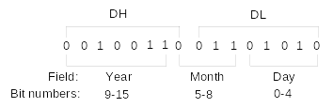
Isolating a Bit String
The MS-DOS file date field packs the year, month, and day into 16 bits:
Isolate the Month field:
mov ax,dx ; make a copy of DX
shr ax,5 ; shift right 5 bits
and al,00001111b ; clear bits 4-7
mov month,al ; save in month variable
Irvine, Kip R. Assembly Language for Intel-Based Computers 5/e, 2007.

Slide 33
What's Next
Shift and Rotate Instructions
Shift and Rotate Applications
Multiplication and Division Instructions
Extended Addition and Subtraction
Irvine, Kip R. Assembly Language for Intel-Based Computers 5/e, 2007.

Slide 34
Multiplication and Division Instructions
MUL Instruction
IMUL Instruction
DIV Instruction
Signed Integer Division
CBW, CWD, CDQ Instructions
IDIV Instruction
Implementing Arithmetic Expressions
Irvine, Kip R. Assembly Language for Intel-Based Computers 5/e, 2007.

Slide 35
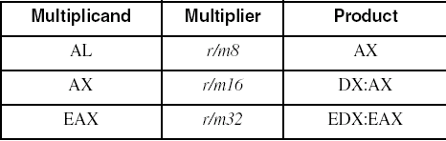
MUL Instruction
The MUL (unsigned multiply) instruction multiplies an 8-, 16-, or 32-bit operand by either AL, AX, or EAX.
The instruction formats are:
    MUL r/m8
    MUL r/m16
    MUL r/m32
Implied operands:
Irvine, Kip R. Assembly Language for Intel-Based Computers 5/e, 2007.

Slide 36
MUL Examples
100h * 2000h, using 16-bit operands:
.data
val1 WORD 2000h
val2 WORD 100h
.code
mov ax,val1
mul val2 ; DX:AX = 00200000h, CF=1
The Carry flag indicates whether or not the upper half of the product contains significant digits.
12345h * 1000h, using 32-bit operands:
mov eax,12345h
mov ebx,1000h
mul ebx ; EDX:EAX = 0000000012345000h, CF=0
Irvine, Kip R. Assembly Language for Intel-Based Computers 5/e, 2007.

Slide 37
IMUL Instruction
IMUL (signed integer multiply ) multiplies an 8-, 16-, or 32-bit signed operand by either AL, AX, or EAX
Preserves the sign of the product by sign-extending it into the upper half of the destination register
Example: multiply 48 * 4, using 8-bit operands:
mov al,48
mov bl,4
imul bl ; AX = 00C0h, CF=OF=1
CF=OF=1 because AH is not a sign extension of AL, which indicates whether or not the lower half of the product contains a sign bit and all significant digits.
Irvine, Kip R. Assembly Language for Intel-Based Computers 5/e, 2007.

Slide 38
IMUL Examples
Multiply 4,823,424 * −423:
mov eax,4823424
mov ebx,-423
imul ebx ; EDX:EAX = FFFFFFFF86635D80h, OF=0
CF=OF=0 because EDX is a sign extension of EAX.
Irvine, Kip R. Assembly Language for Intel-Based Computers 5/e, 2007.

Slide 39
Your turn . . .
What will be the hexadecimal values of DX, AX, and the Carry flag after the following instructions execute?
mov ax,1234h
mov bx,100h
mul bx
DX = 0012h, AX = 3400h, CF = 1
Irvine, Kip R. Assembly Language for Intel-Based Computers 5/e, 2007.

Slide 40
Your turn . . .
What will be the hexadecimal values of DX, AX, and the Carry flag and Overflow flag after the following instructions execute?
mov ax,8760h
mov bx,100h
imul bx
DX = FF87h, AX = 6000h, CF=OF = 1
Irvine, Kip R. Assembly Language for Intel-Based Computers 5/e, 2007.

Slide 41
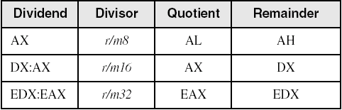
DIV Instruction
The DIV (unsigned divide) instruction performs 8-bit, 16-bit, and 32-bit division on unsigned integers
A single operand is supplied (register or memory operand), which is assumed to be the divisor
Divide overflow and divide 0 will cause exception
Instruction formats:
    DIV r/m8
    DIV r/m16
    DIV r/m32
Default Operands:
Irvine, Kip R. Assembly Language for Intel-Based Computers 5/e, 2007.

Slide 42
DIV Examples
Divide 8003h by 100h, using 16-bit operands:
mov dx,0 ; clear dividend, high
mov ax,8003h ; dividend, low
mov cx,100h ; divisor
div cx ; AX = 0080h, DX = 3
Same division, using 32-bit operands:
mov edx,0 ; clear dividend, high
mov eax,8003h ; dividend, low
mov ecx,100h ; divisor
div ecx ; EAX = 00000080h, DX = 3
Irvine, Kip R. Assembly Language for Intel-Based Computers 5/e, 2007.

Slide 43
Your turn . . .
What will be the hexadecimal values of DX and AX after the following instructions execute? Or, if divide overflow occurs, you can indicate that as your answer:
mov dx,0087h
mov ax,6000h
mov bx,100h
div bx
DX = 0000h, AX = 8760h
Irvine, Kip R. Assembly Language for Intel-Based Computers 5/e, 2007.

Slide 44
Your turn . . .
What will be the hexadecimal values of DX and AX after the following instructions execute? Or, if divide overflow occurs, you can indicate that as your answer:
mov dx,0087h
mov ax,6002h
mov bx,10h
div bx
Divide Overflow
Irvine, Kip R. Assembly Language for Intel-Based Computers 5/e, 2007.

Slide 45
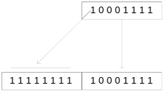
Signed Integer Division
Signed integers must be sign-extended before division takes place
  fill high byte/word/doubleword with a copy of the low byte/word/doubleword's sign bit
For example, the high byte contains a copy of the sign bit from the low byte:
Irvine, Kip R. Assembly Language for Intel-Based Computers 5/e, 2007.

Slide 46
CBW, CWD, CDQ Instructions
The CBW, CWD, and CDQ instructions provide important sign-extension operations:
  CBW (convert byte to word) extends AL into AH
  CWD (convert word to doubleword) extends AX into DX
  CDQ (convert doubleword to quadword) extends EAX into EDX
Example:
    mov eax,0FFFFFF9Bh ; (-101)
    cdq ; EDX:EAX = FFFFFFFFFFFFFF9Bh
Irvine, Kip R. Assembly Language for Intel-Based Computers 5/e, 2007.

Slide 47
IDIV Instruction
IDIV (signed divide) performs signed integer division
Same syntax and operands as DIV instruction
Example: 8-bit division of –48 by 5
mov al,-48
cbw ; extend AL into AH
mov bl,5
idiv bl ; AL = -9, AH = -3
Irvine, Kip R. Assembly Language for Intel-Based Computers 5/e, 2007.

Slide 48
IDIV Examples
Example: 16-bit division of –48 by 5
mov ax,-48
cwd ; extend AX into DX
mov bx,5
idiv bx ; AX = -9, DX = -3
Example: 32-bit division of –48 by 5
mov eax,-48
cdq ; extend EAX into EDX
mov ebx,5
idiv ebx ; EAX = -9, EDX = -3
Irvine, Kip R. Assembly Language for Intel-Based Computers 5/e, 2007.

Slide 49
Unsigned Arithmetic Expressions
Some good reasons to learn how to implement integer expressions:
  Learn how compilers do it
  Test your understanding of MUL, IMUL, DIV, IDIV
  Check for overflow (Carry and Overflow flags)
Example: var4 = (var1 + var2) * var3
; Assume unsigned operands
mov eax,var1
add eax,var2 ; EAX = var1 + var2
mul var3 ; EAX = EAX * var3
jc TooBig ; check for carry
mov var4,eax ; save product
Irvine, Kip R. Assembly Language for Intel-Based Computers 5/e, 2007.

Slide 50
Signed Arithmetic Expressions (1 of 2)
Example: eax = (-var1 * var2) + var3
mov eax,var1
neg eax
imul var2
jo TooBig ; check for overflow
add eax,var3
jo TooBig ; check for overflow
Example: var4 = (var1 * 5) / (var2 – 3)
mov eax,var1 ; left side
mov ebx,5
imul ebx ; EDX:EAX = product
mov ebx,var2 ; right side
sub ebx,3
idiv ebx ; EAX = quotient
mov var4,eax
Irvine, Kip R. Assembly Language for Intel-Based Computers 5/e, 2007.

Slide 51
Signed Arithmetic Expressions (2 of 2)
Example: var4 = (var1 * -5) / (-var2 % var3);
mov eax,var2 ; begin right side
neg eax
cdq ; sign-extend dividend
idiv var3 ; EDX = remainder
mov ebx,edx ; EBX = right side
mov eax,-5 ; begin left side
imul var1 ; EDX:EAX = left side
idiv ebx ; final division
mov var4,eax ; quotient
Sometimes it's easiest to calculate the right-hand term of an expression first.
Irvine, Kip R. Assembly Language for Intel-Based Computers 5/e, 2007.

Slide 52
Your turn . . .
Implement the following expression using signed 32-bit integers. Do not modify any variables other than var3:
var3 = (var1 * -var2) / (var3 – ebx)
mov eax,var1
mov edx,var2
neg edx
imul edx ; left side: EDX:EAX
mov ecx,var3
sub ecx,ebx
idiv ecx ; EAX = quotient
mov var3,eax
Irvine, Kip R. Assembly Language for Intel-Based Computers 5/e, 2007.

Slide 53
What's Next
Shift and Rotate Instructions
Shift and Rotate Applications
Multiplication and Division Instructions
Extended Addition and Subtraction
Irvine, Kip R. Assembly Language for Intel-Based Computers 5/e, 2007.

Slide 54
Extended Addition and Subtraction
ADC Instruction
Extended Precision Addition
SBB Instruction
Extended Precision Subtraction
Irvine, Kip R. Assembly Language for Intel-Based Computers 5/e, 2007.

Slide 55
Extended Precision Addition
Adding two operands that are longer than the computer's word size (32 bits).
  Virtually no limit to the size of the operands
The arithmetic must be performed in steps
  The Carry value from each step is passed on to the next step.
Irvine, Kip R. Assembly Language for Intel-Based Computers 5/e, 2007.

Slide 56
ADC Instruction
ADC (add with carry) instruction adds both a source operand and the contents of the Carry flag to a destination operand.
Operands are binary values
  Same syntax as ADD, SUB, etc.
Example
  Add two 32-bit integers (FFFFFFFFh + FFFFFFFFh), producing a 64-bit sum in EDX:EAX:
    mov edx,0
    mov eax,0FFFFFFFFh
    add eax,0FFFFFFFFh
    adc edx,0 ;EDX:EAX = 00000001FFFFFFFEh
Irvine, Kip R. Assembly Language for Intel-Based Computers 5/e, 2007.

Slide 57
Extended Addition Example
Task: Add 1 to EDX:EAX
  Starting value of EDX:EAX: 00000000FFFFFFFFh
  Add the lower 32 bits first, setting the Carry flag.
  Add the upper 32 bits, and include the Carry flag.
mov edx,0 ; set upper half
mov eax,0FFFFFFFFh ; set lower half
add eax,1 ; add lower half
adc edx,0 ; add upper half
    EDX:EAX = 00000001 00000000
Irvine, Kip R. Assembly Language for Intel-Based Computers 5/e, 2007.

Slide 58
SBB Instruction
The SBB (subtract with borrow) instruction subtracts both a source operand and the value of the Carry flag from a destination operand.
Operand syntax:
  Same as for the ADC instruction
Irvine, Kip R. Assembly Language for Intel-Based Computers 5/e, 2007.

Slide 59
Extended Subtraction Example
Task: Subtract 1 from EDX:EAX
  Starting value of EDX:EAX: 0000000100000000h
  Subtract the lower 32 bits first, setting the Carry flag.
  Subtract the upper 32 bits, and include the Carry flag.
mov edx,1 ; set upper half
mov eax,0 ; set lower half
sub eax,1 ; subtract lower half
sbb edx,0 ; subtract upper half
EDX:EAX = 00000000 FFFFFFFF
Irvine, Kip R. Assembly Language for Intel-Based Computers 5/e, 2007.

Slide 60
Summary
Shift and rotate instructions are some of the best tools of assembly language
  finer control than in high-level languages
  SHL, SHR, SAR, ROL, ROR, RCL, RCR
MUL and DIV – integer operations
  close relatives of SHL and SHR
  CBW, CDQ, CWD: preparation for division
Extended precision arithmetic: ADC, SBB
Irvine, Kip R. Assembly Language for Intel-Based Computers 5/e, 2007.

Slide 61

The End
Irvine, Kip R. Assembly Language for Intel-Based Computers 5/e, 2007.

